Slide 1
Neurodiversity and Technological Practices
Presenting: Kara Starnes and Caroline Waldbuesser
Additional Contributors: Evan Kirksey

Slide 2
Agenda
Discuss neurodiversity as a framework for understanding cogntive differences.
Overview how neurodiversity can impact learning.
Consider how technology influences neurodiverse learners.
Explore specific programs to help neurodiverse students.

Slide 3
What is neurodiversity?
"Neurodiversity describes the idea that people experience and interact with the world around them in many different ways; there is no one 'right' way of thinking, learning, and behaving, and differences are not viewed as deficits" (Baumer & Frueh, 2021, para. 1).

Slide 4
How common is neurodiversity in the classroom?
Neurodiversity is an umbrella term that covers cognitive differences such as autism, ADHD, dyslexia, general anxiety, depression, language disorders, amongst others (Schaefer & Sanchez, 2024).
It is estimated that anywhere between 10%-30% of college students are neurodiverse, depending on the university and willingness to report (Schaefer & Sanchez, 2024).

Slide 5
How does neurodiversity affect learning?
Neurodiversity can affect:
  Engagement
  Ability to ask questions/ask for help
  Attention during class
  Understanding of materials
  Groupwork
  Ability to work in the online environment

Slide 6
How have you seen this affect your class?
How have you encountered neurodiversity in the classroom?
What changes have you made to help address these experiences?
Have you as an instructor thrived/struggled with teaching based on your own neurodiversity (if applicable)?

Slide 7
Technology and Neurodiversity: How it can help
It can help with organization and keeping track of events (Chen et al, 2026)
It can also help with focus and stimulation.
It can also help with reading and writing down ideas.
It can help with brainstorming (Rick et al, 2023)

Slide 8
Technology and Neurodiversity: How it can hurt
It can distract students at times (Deshmukh, 2025).
Some software programs are behind a paywall and costly.
Learning technology can create additional stress.
Over reliance on tech and AI (Chen et al, 2026; He et al, 2023; Qiao et al,2025).

Slide 9
Universal Design for Learning
What do you know about Universal Design for Learning (UDL)?
How would you explain UDL?
How could apply it to neurodiverse learners?

Slide 10
Approaches to technology in the in-person classroom
Allow breaks during lecture.
Acknowledge some students might need to be doing multiple things at the same time.
Post class materials (slides, directions for activities, etc.) to Canvas when appropriate.
Consider making lecture more interactive through technology and/or guided notes.

Slide 11
Approaches to online courses
Send reminders and announcements to students throughout the week.
Provide directions for assignments in multiple ways (i.e., writing, video).
Post a video explaining the setup of Canvas and expected technology use in your welcome module.

Slide 12
Approaches to technology general recommendations
Include links to resources in syllabus and/or on Canvas.
Encourage students to explore programs to help with reading, keeping organized, tracking ideas, etc.
Make sure your Canvas pages follow ADA compliance standards.
Offer to meet with students to explain technology use expectations.

Slide 13
Approaches to assignments
Provide multiple ways to complete assignments when appropriate (e.g., written papers, videos, slideshows).
Make quizzes and/or attendance questions more interactive with platforms such as Kahoot!

Slide 14
Specific Programs
Kahoot!
Notebook LM and other AI Platforms
Voice-to-text programs (Microsoft Dictate).
Read aloud functions through various platforms (audiobooks, research articles, Microsoft, etc.).
Outlook Calendar
Phone Apps (Obsidian, Google Calendar, Todoist).

Slide 15
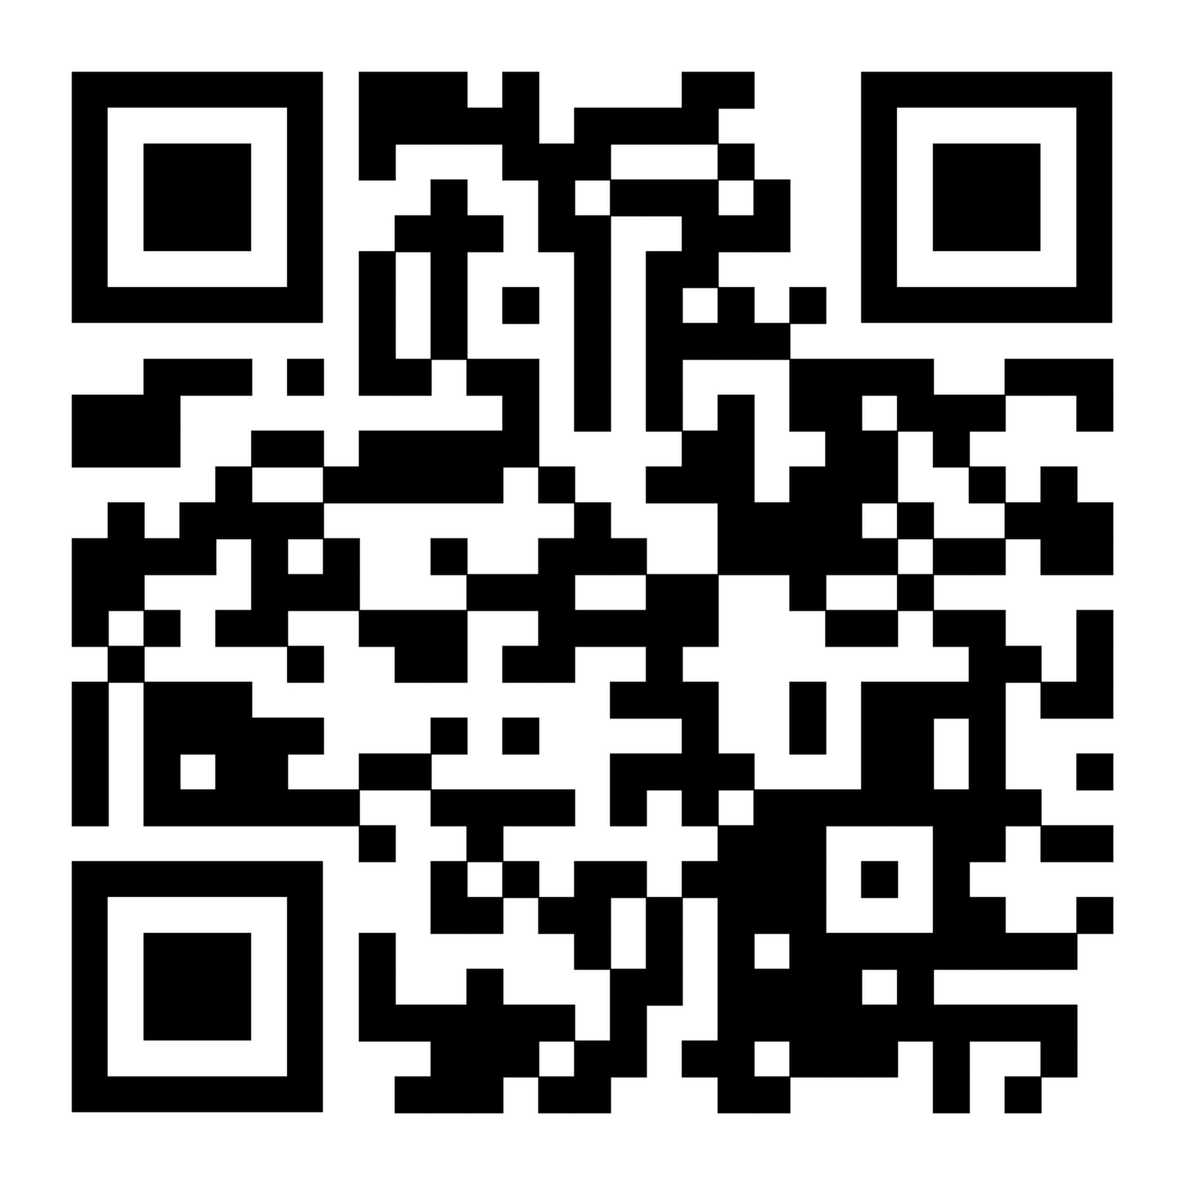
Campus and Outside Resource Links
https://docs.google.com/document/d/1PVAoHspdqj_KBmkxAXLu0mMogQLGk5GTvym_Zg6GZbE/edit?tab=t.0

Slide 16
Examples
Notebook LM
Microsoft Dictate and Read Aloud
What programs have you found helpful for organization, reminders, etc.?

Slide 17
Takeaway
Based on our discussion, pick one of you classes you are teaching in the fall semester.
How can you apply at least one idea from today in your class?

Slide 18
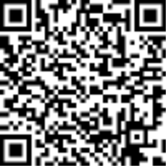
Feedback

Slide 19
References
Baumer, N., & Frueh, J. (2021, November 23). What is neurodiversity? Harvard Health. Retrieved May 18 from https://www.health.harvard.edu/blog/what-is-neurodiversity-202111232645
Chen, J., Meng, Y., & Nie, K. (2026). “Not just me and my to-do list”: Understanding challenges of task management for adults with ADHD and the need for AI-augmented social scaffolds. arXiv. https://arxiv.org/abs/2603.17258
Deshmukh, R. (2025, October). Toward neurodivergent-aware productivity: A systems and AI-based human-in-the-loop framework for ADHD-affected professionals. In Proceedings of the 16th Biannual Conference of the Italian SIGCHI Chapter (pp. 1–6).
He, J., Piorkowski, D., Muller, M., Brimijoin, K., Houde, S., & Weisz, J. (2023). Rebalancing worker initiative and AI initiative in future work: Four task dimensions. In Proceedings of the 2nd Annual Meeting of the Symposium on Human-Computer Interaction for Work (Article 3, pp. 1–16). Association for Computing Machinery. https://doi.org/10.1145/3596671.359857
Qiao, H., Vermeulen, J., Fitzmaurice, G., & Matejka, J. (2025). To use or not to use: Impatience and overreliance when using generative AI productivity support tools. In Proceedings of the 2025 CHI Conference on Human Factors in Computing Systems. Association for Computing Machinery.
Rick, S. R., Giacomelli, G., Wen, H., Laubacher, R. J., Taubenslag, N., Heyman, J. L., et al. (2023). Supermind ideator: Exploring generative AI to support creative problem-solving. arXiv. https://arxiv.org/abs/2311.01937
Schaefer, J., & Sanchez, A. (2024, March 15). Shining a light on neurodiversity in higher ed. University of Wisconsin-Madision: School of Education. Retrieved May 18 from https://education.wisc.edu/news/shining-a-light-on-neurodiversity-in-higher-ed/

