Slide 1
Wellbeing in Leadership: Ensuring the Success of Those You Lead
Karen Thies, PhD, DO, Director of OB/GYN and Women's Health Wellbeing Program
Melissa Terry MD, Director of Ambulatory Services, Women’s Health and Director of Low Intervention Birth Program
Celebration of Teaching 2026

Slide 2
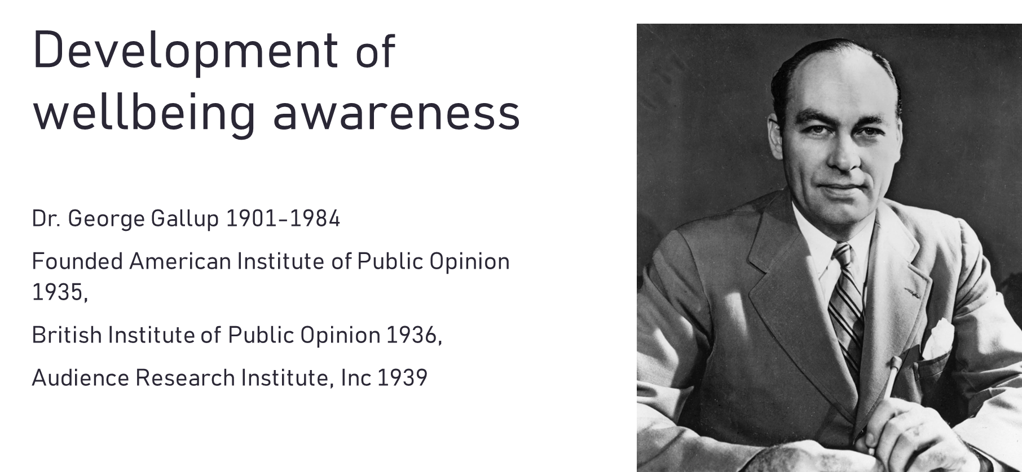

Slide 3
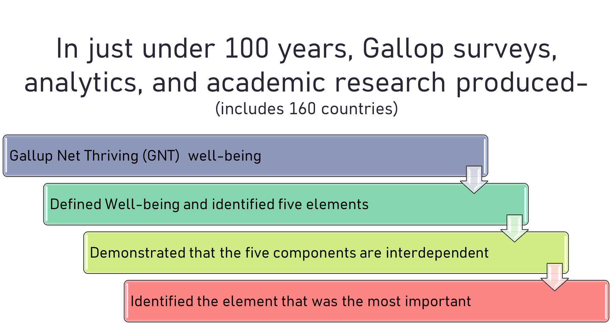

Slide 4
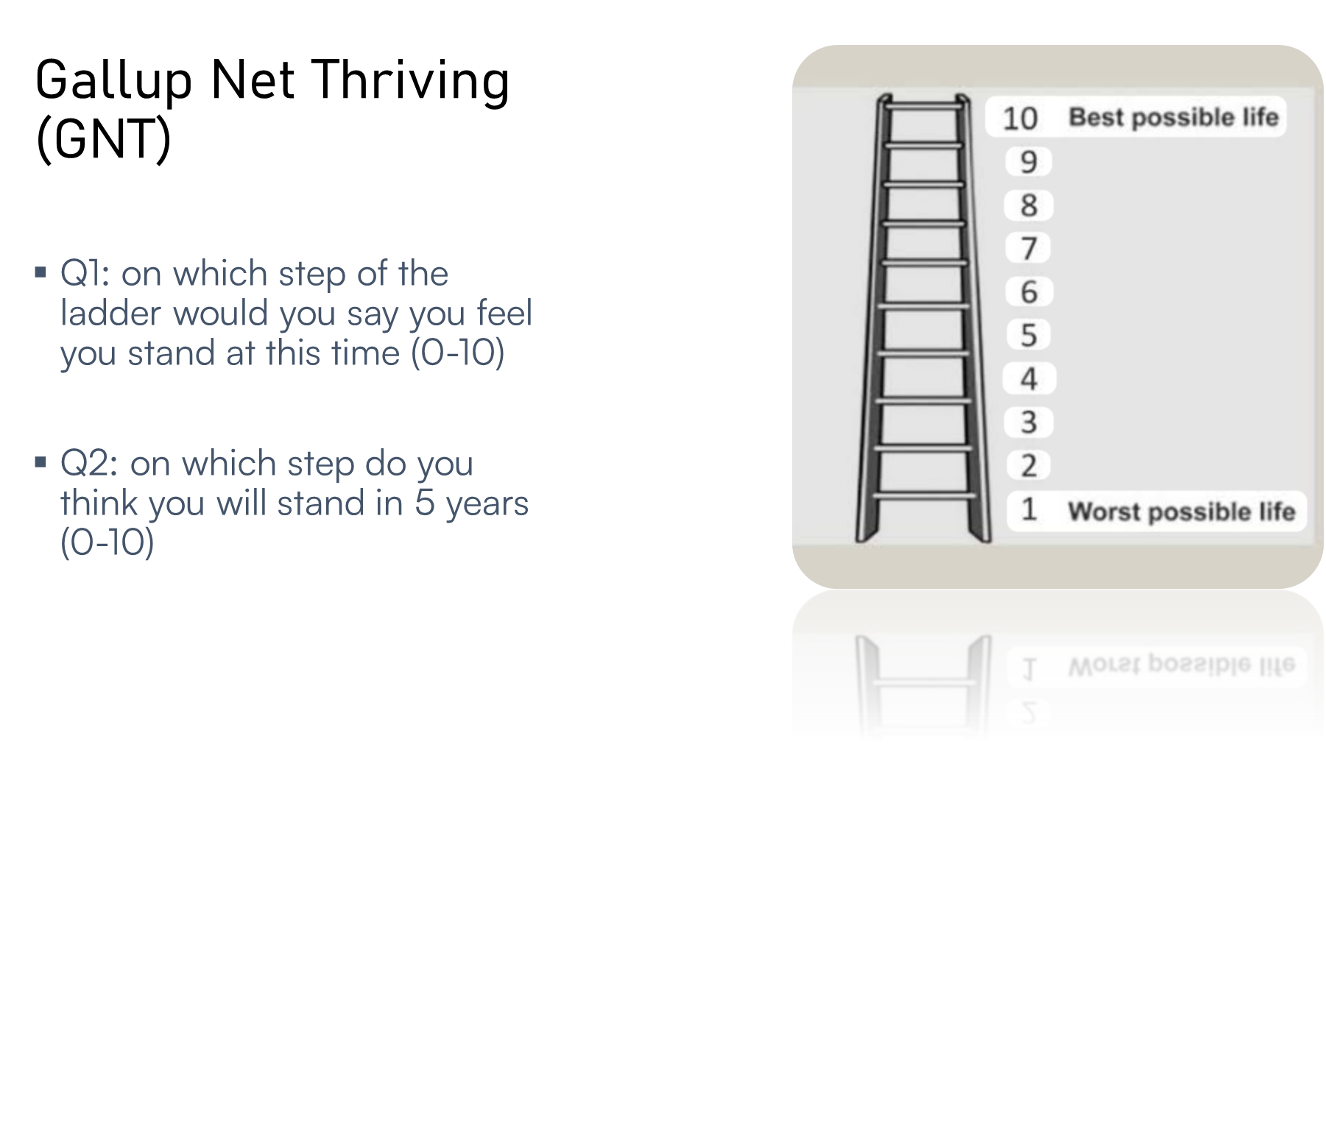

Slide 5
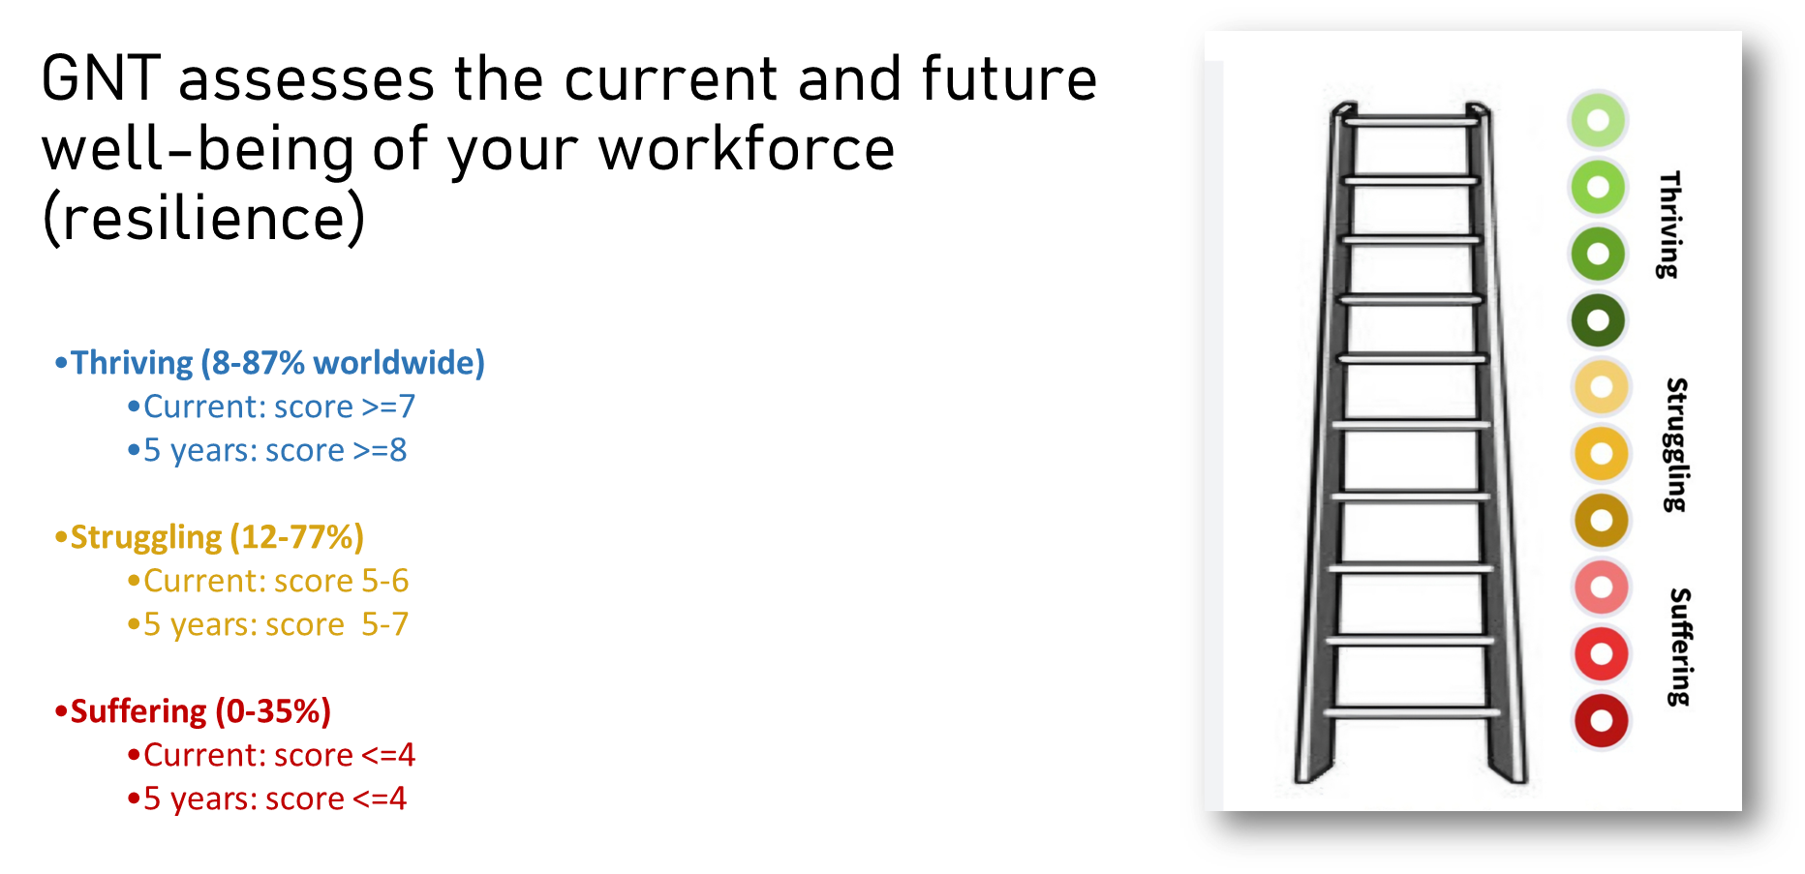

Slide 6
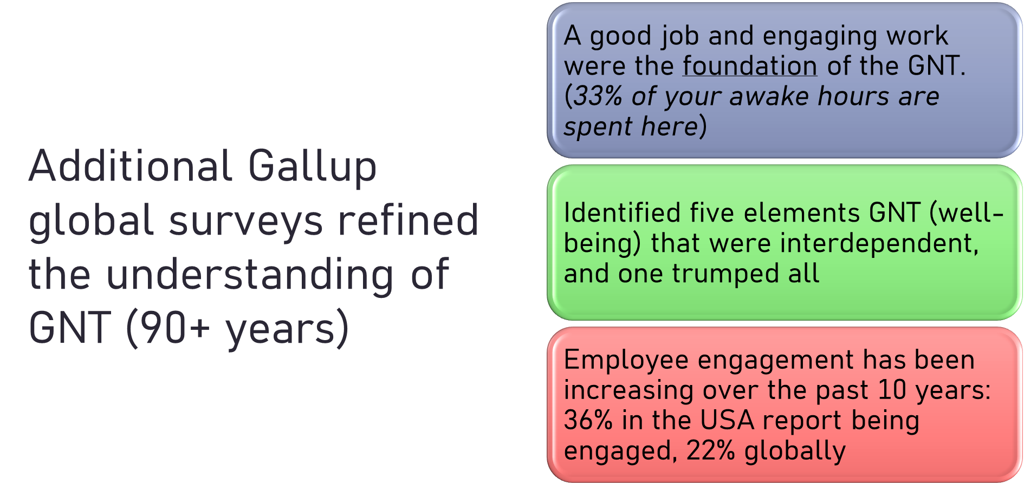

Slide 7


Slide 8
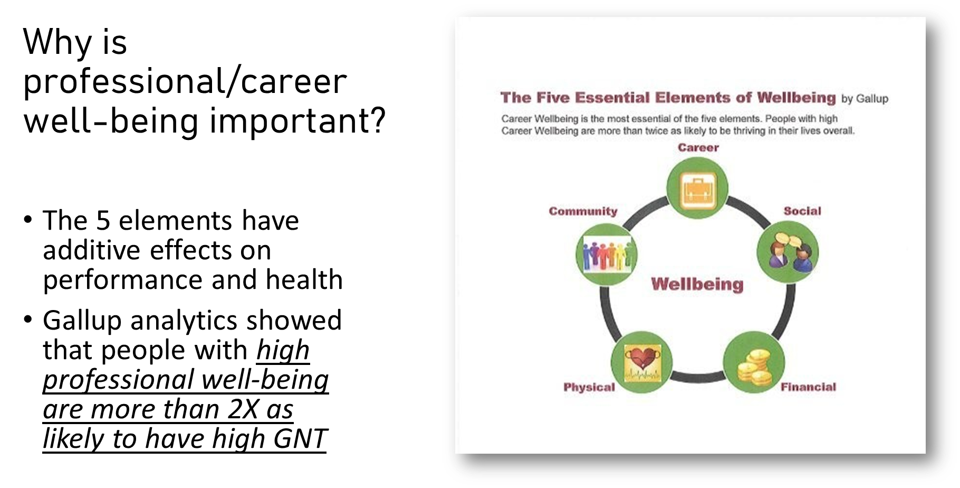

Slide 9
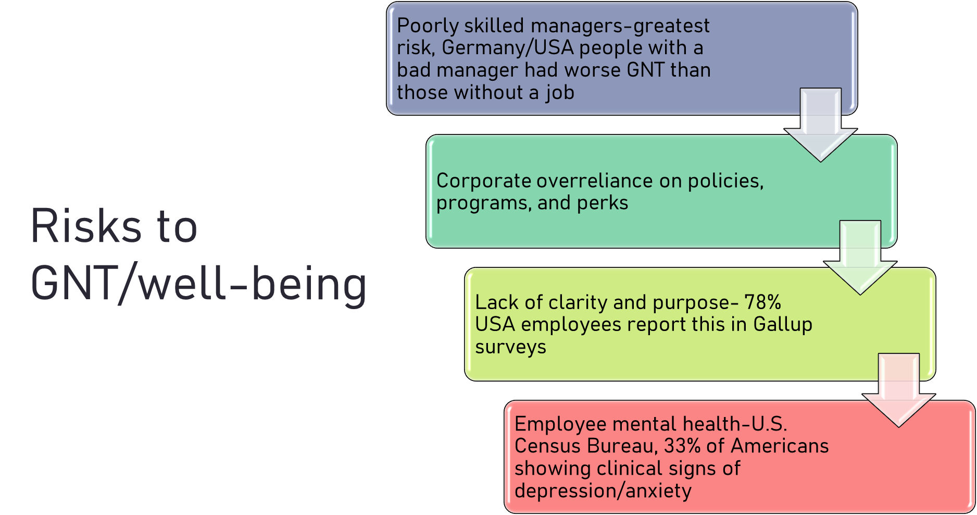

Slide 10
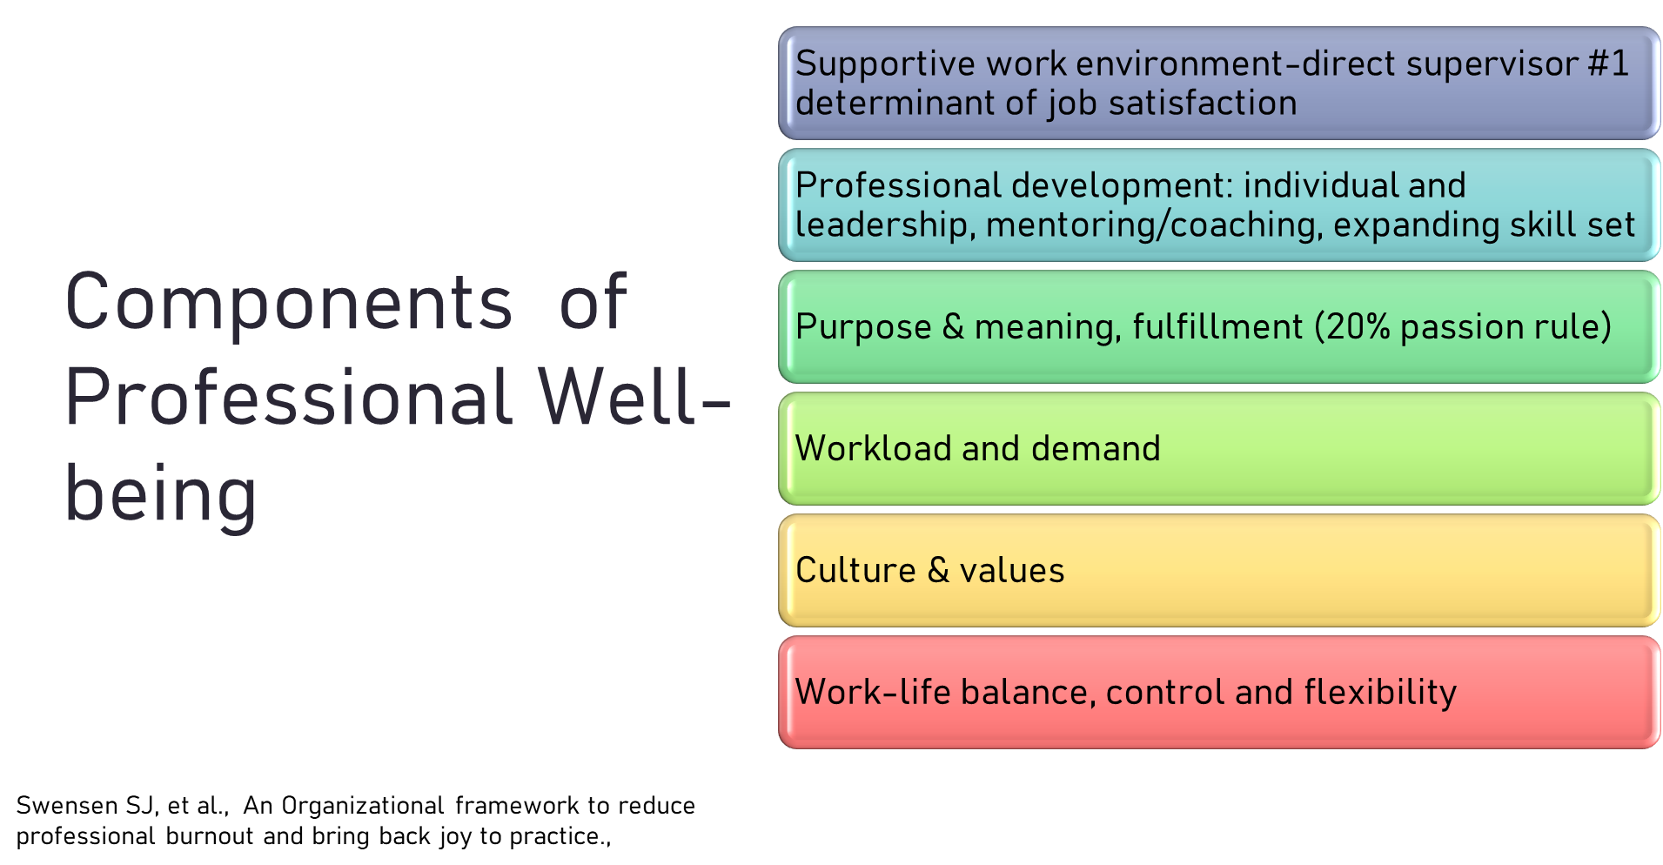

Slide 11


Slide 12
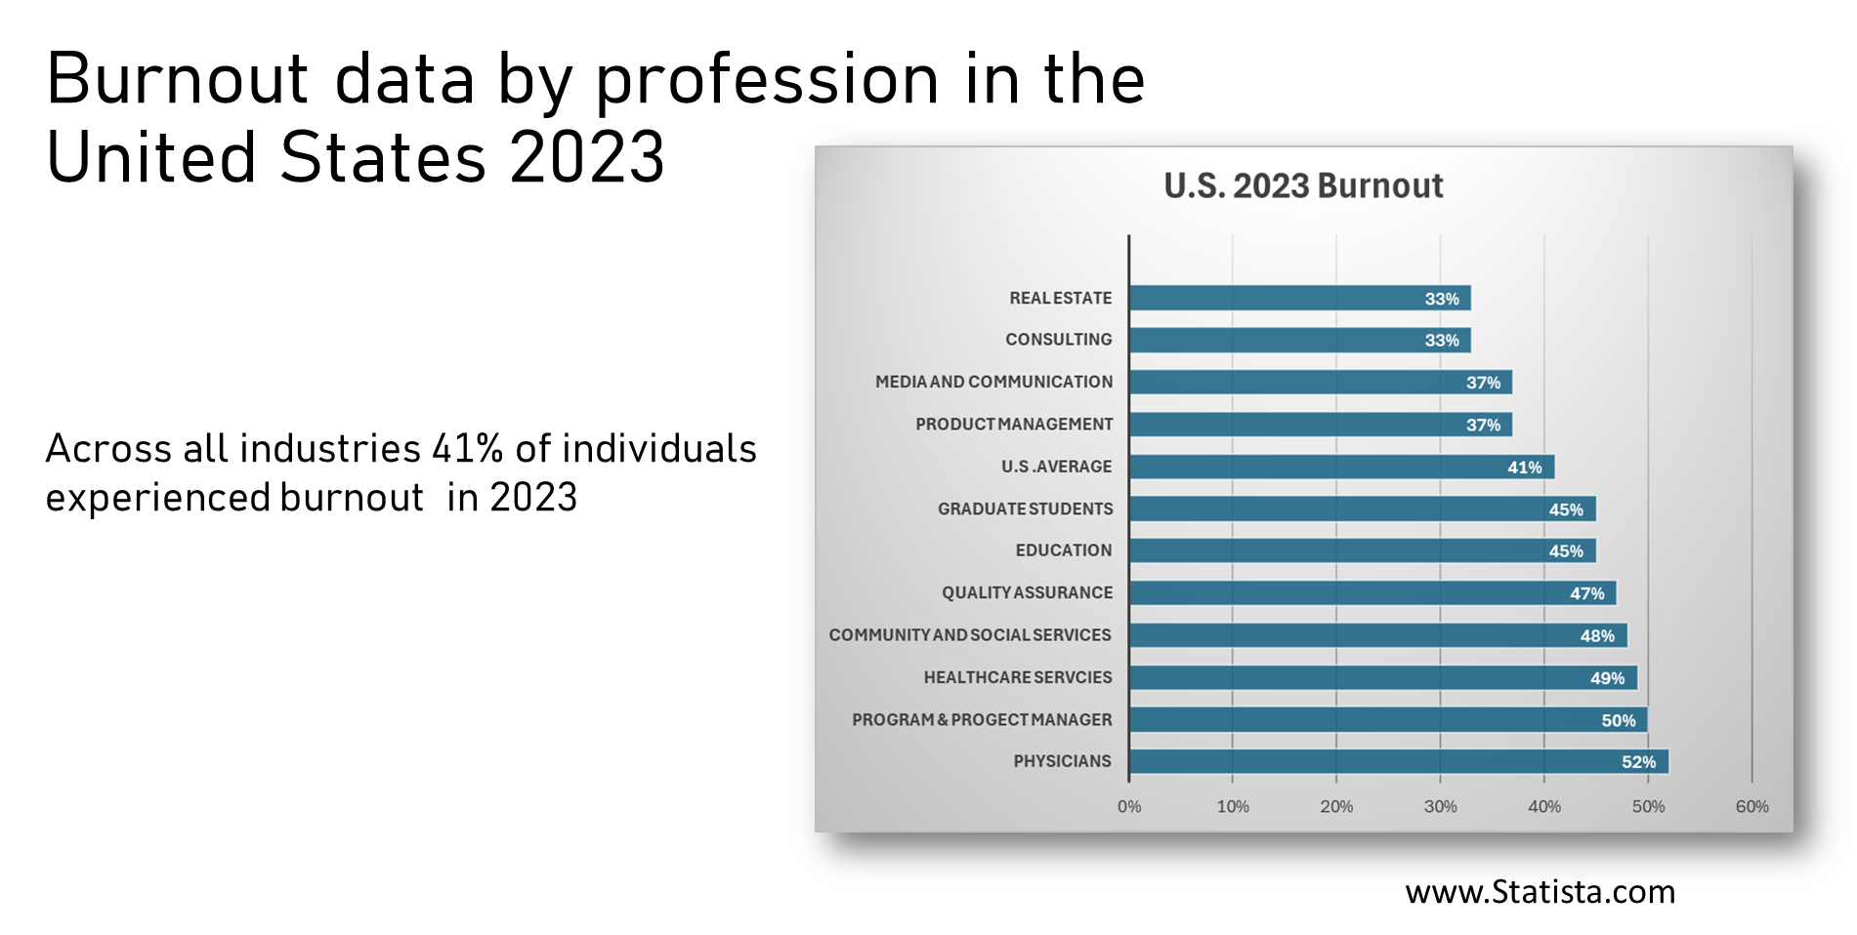

Slide 13


Slide 14


Slide 15
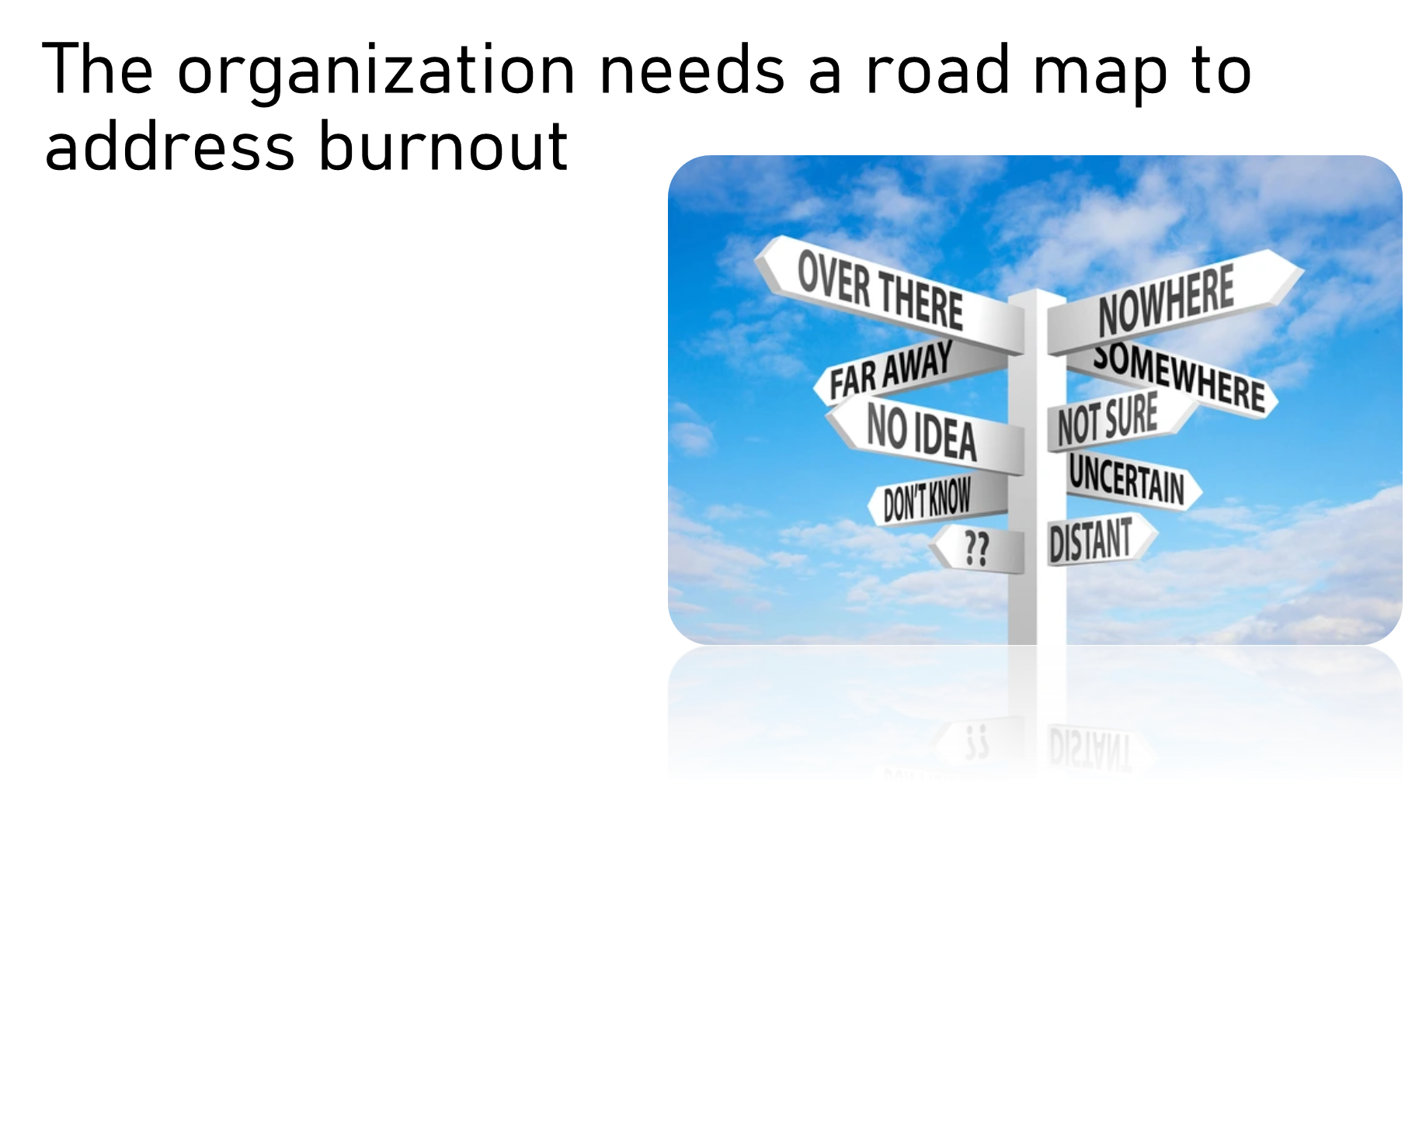

Slide 16
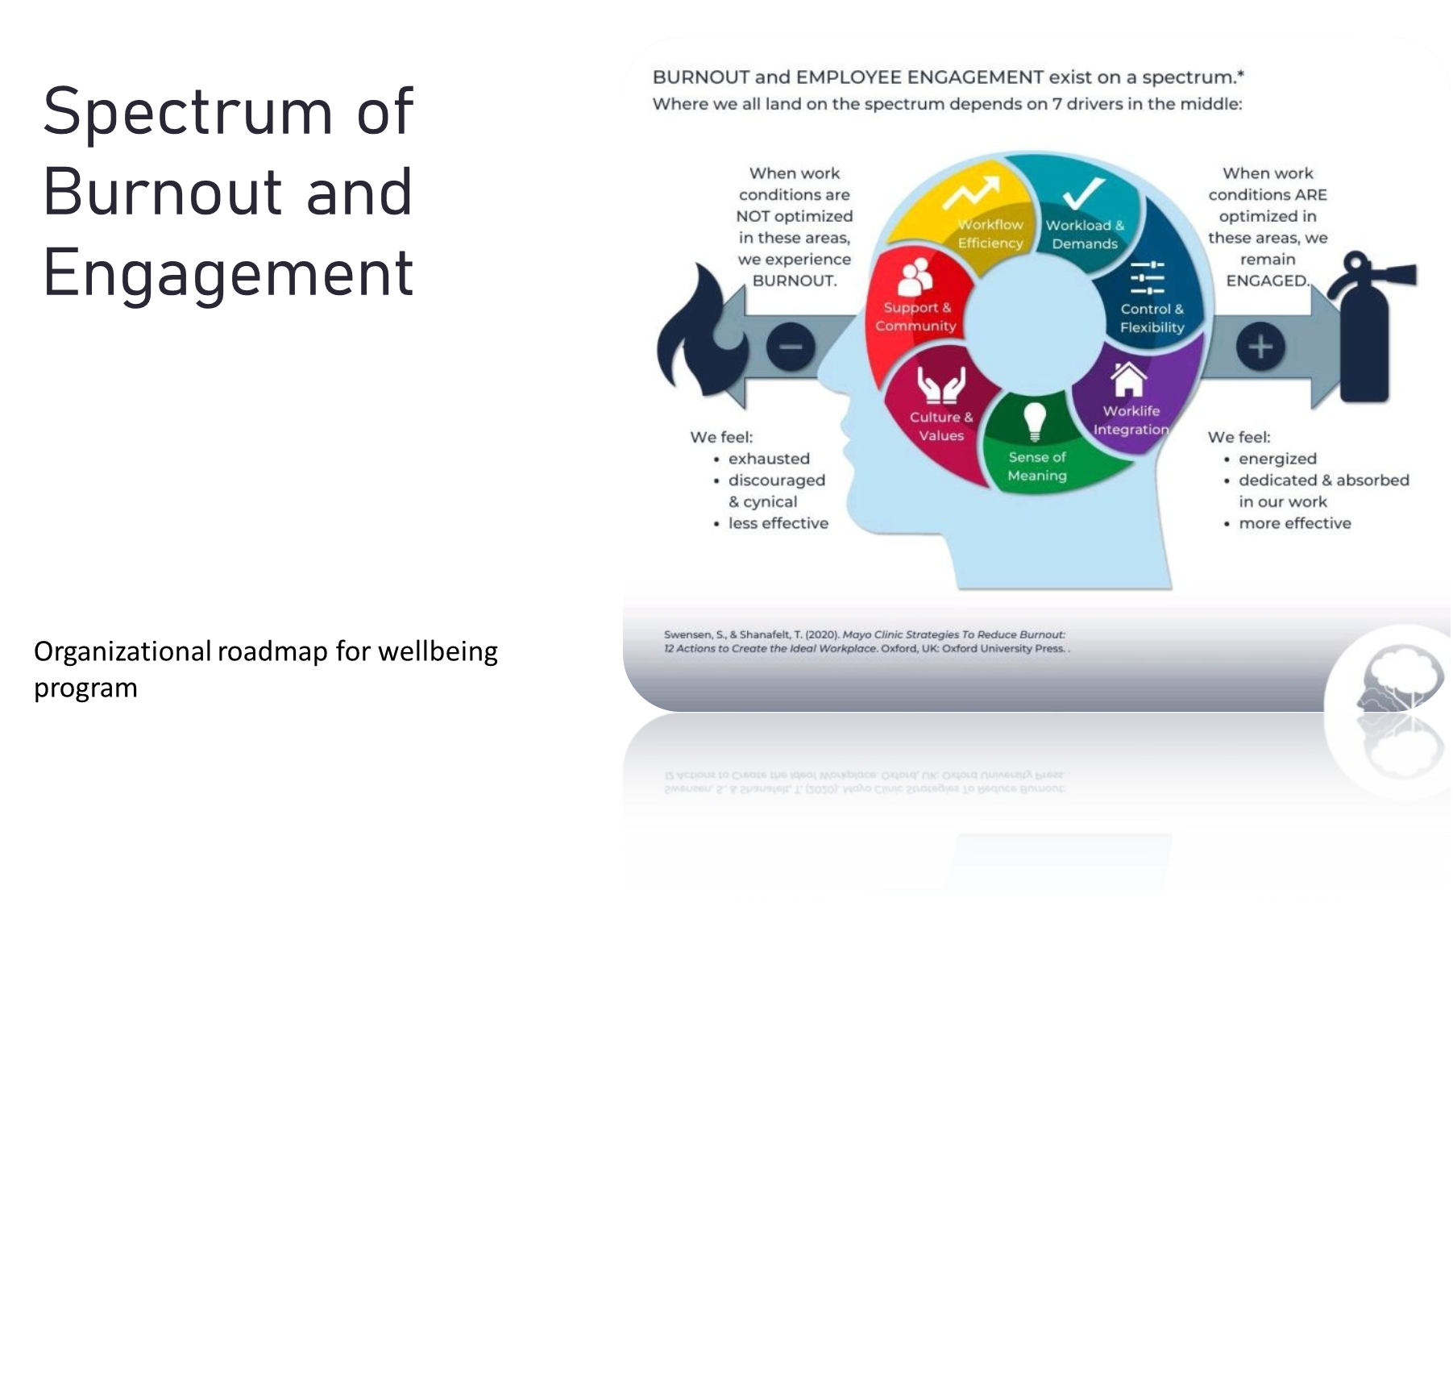

Slide 17
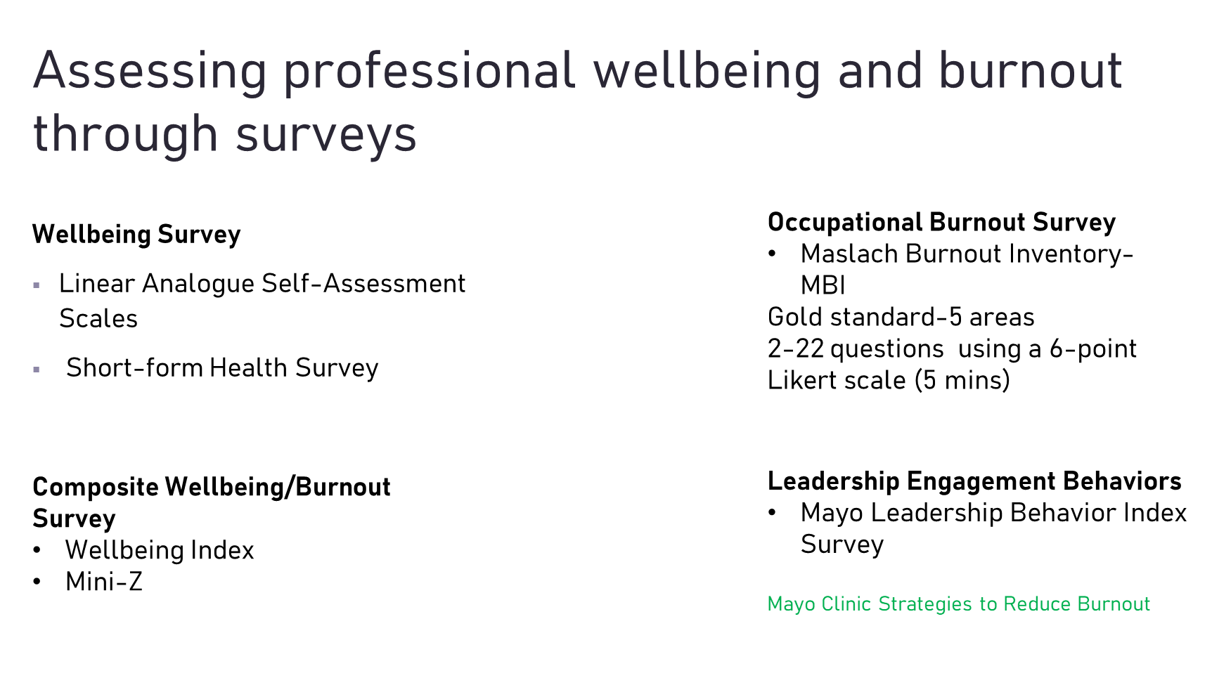

Slide 18
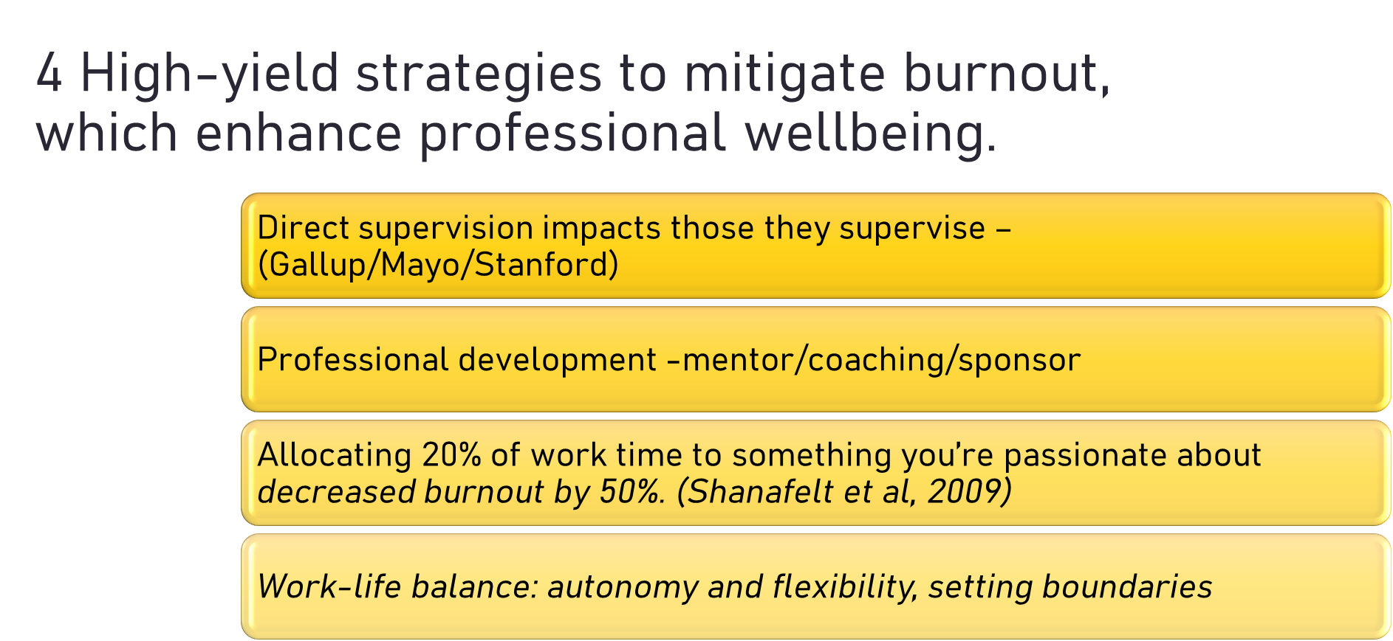

Slide 19
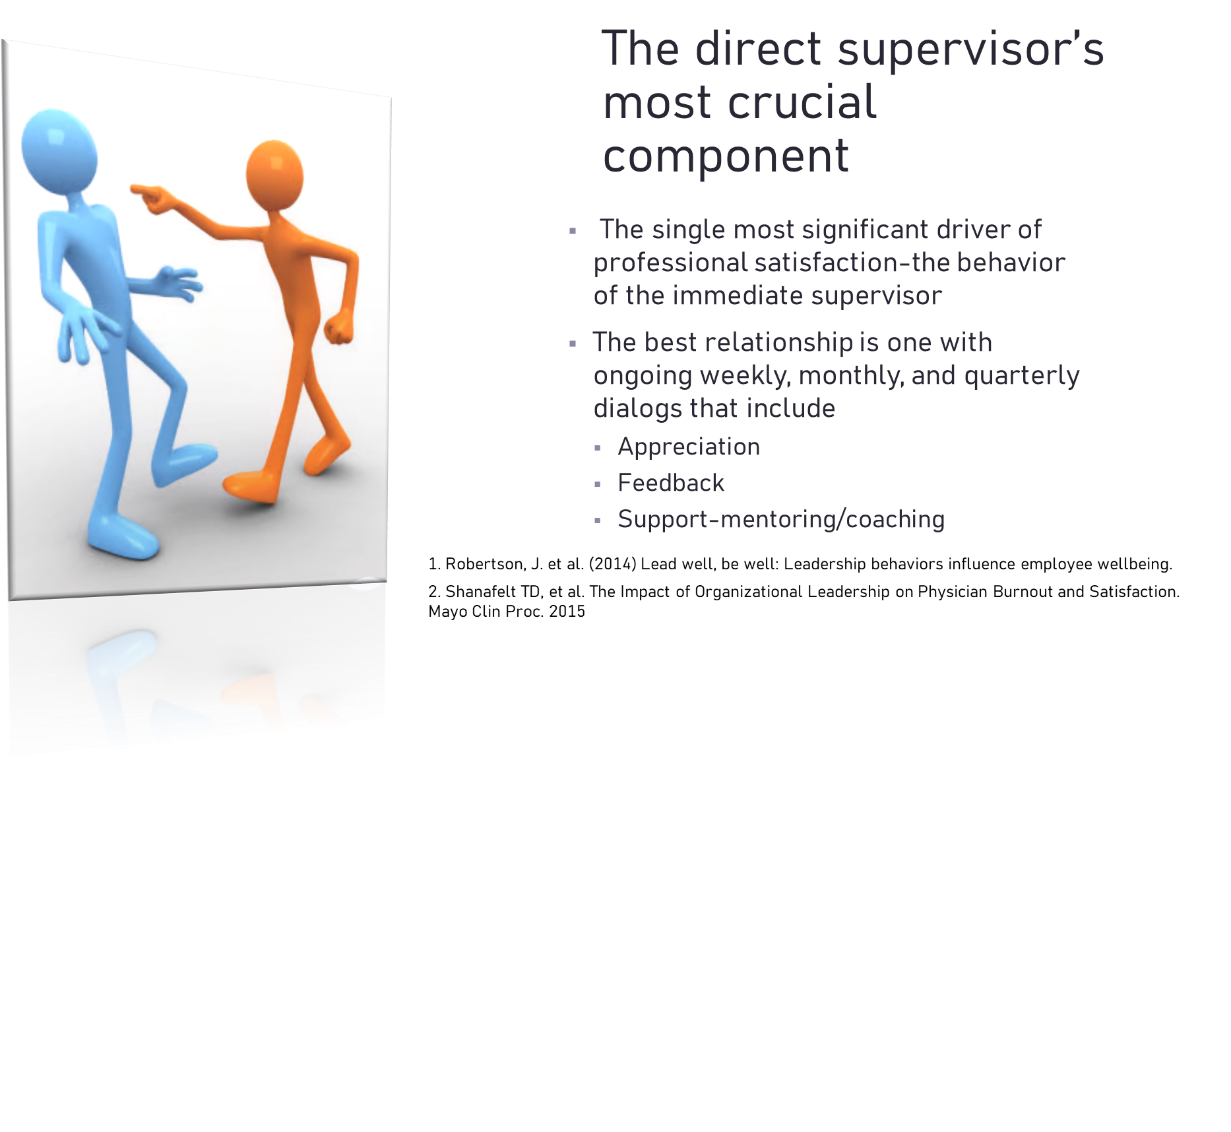

Slide 20
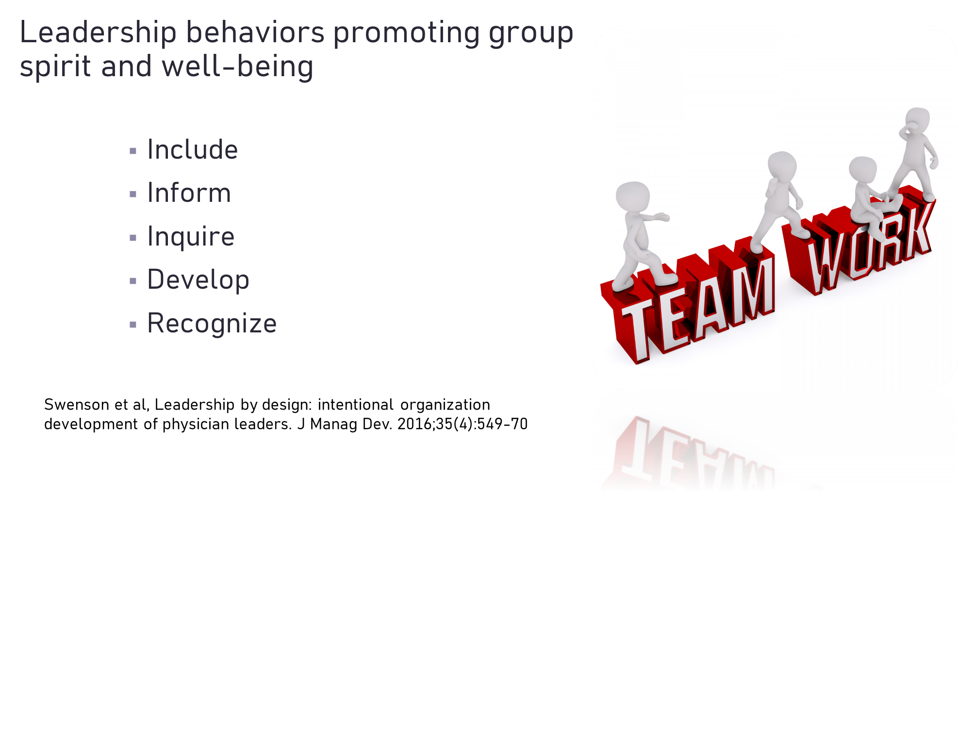

Slide 21
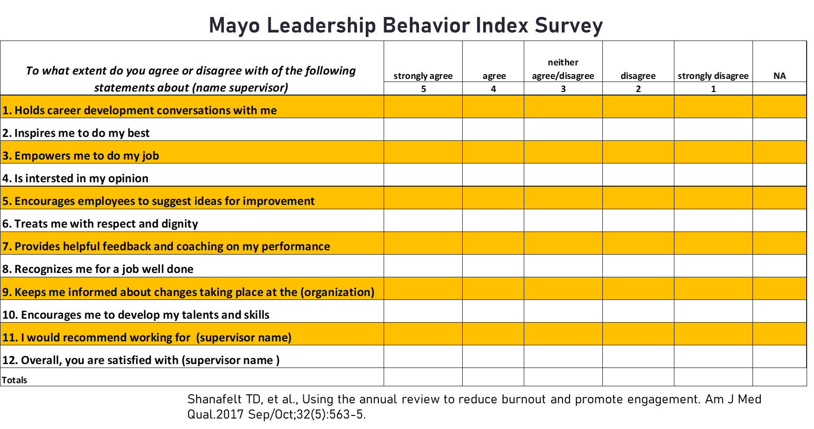

Slide 22
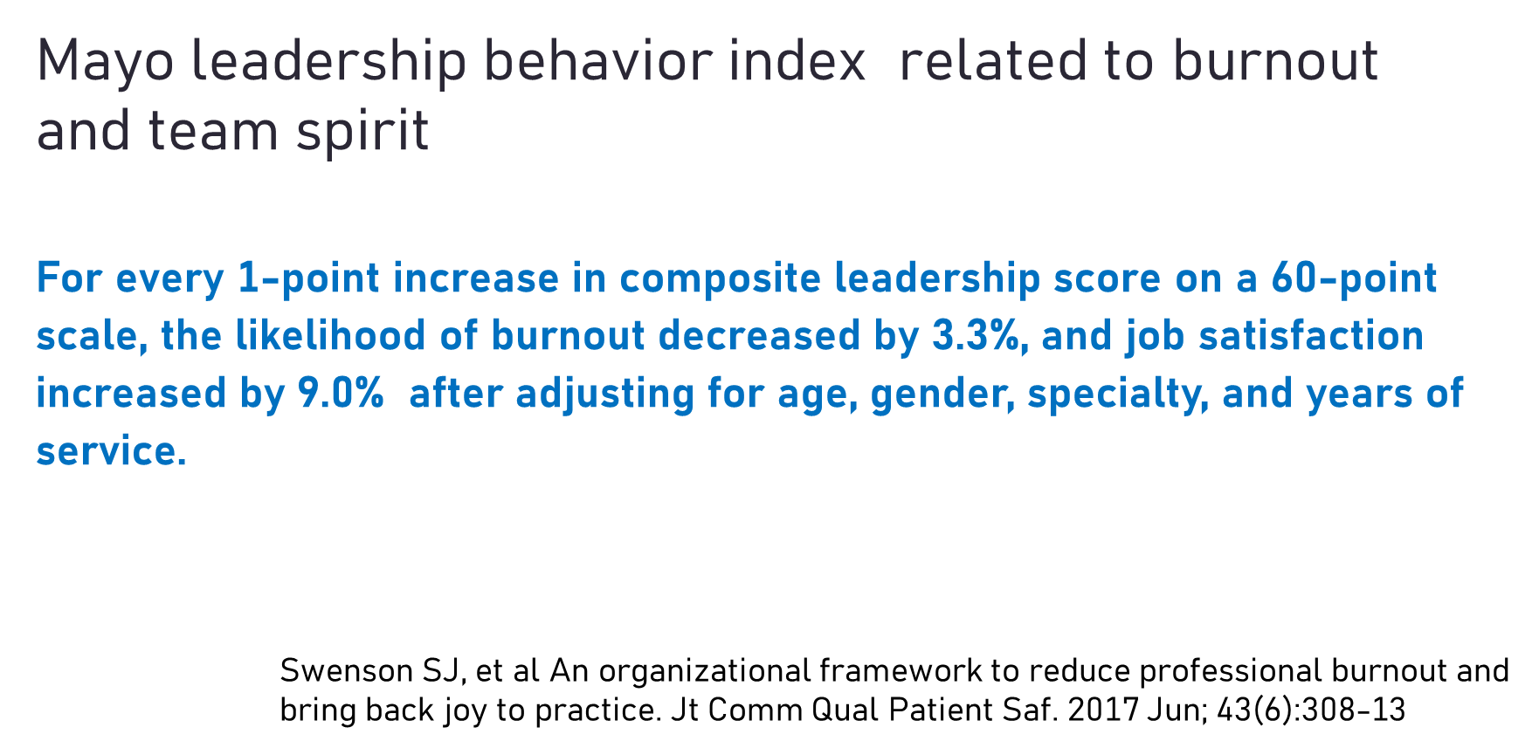

Slide 23
How to implement the 5 core wellbeing leadership metrics with those you lead.
Melissa Terry, MD, Director of Ambulatory Services, Women’s Health and Director of Low Intervention Birth Program

Slide 24
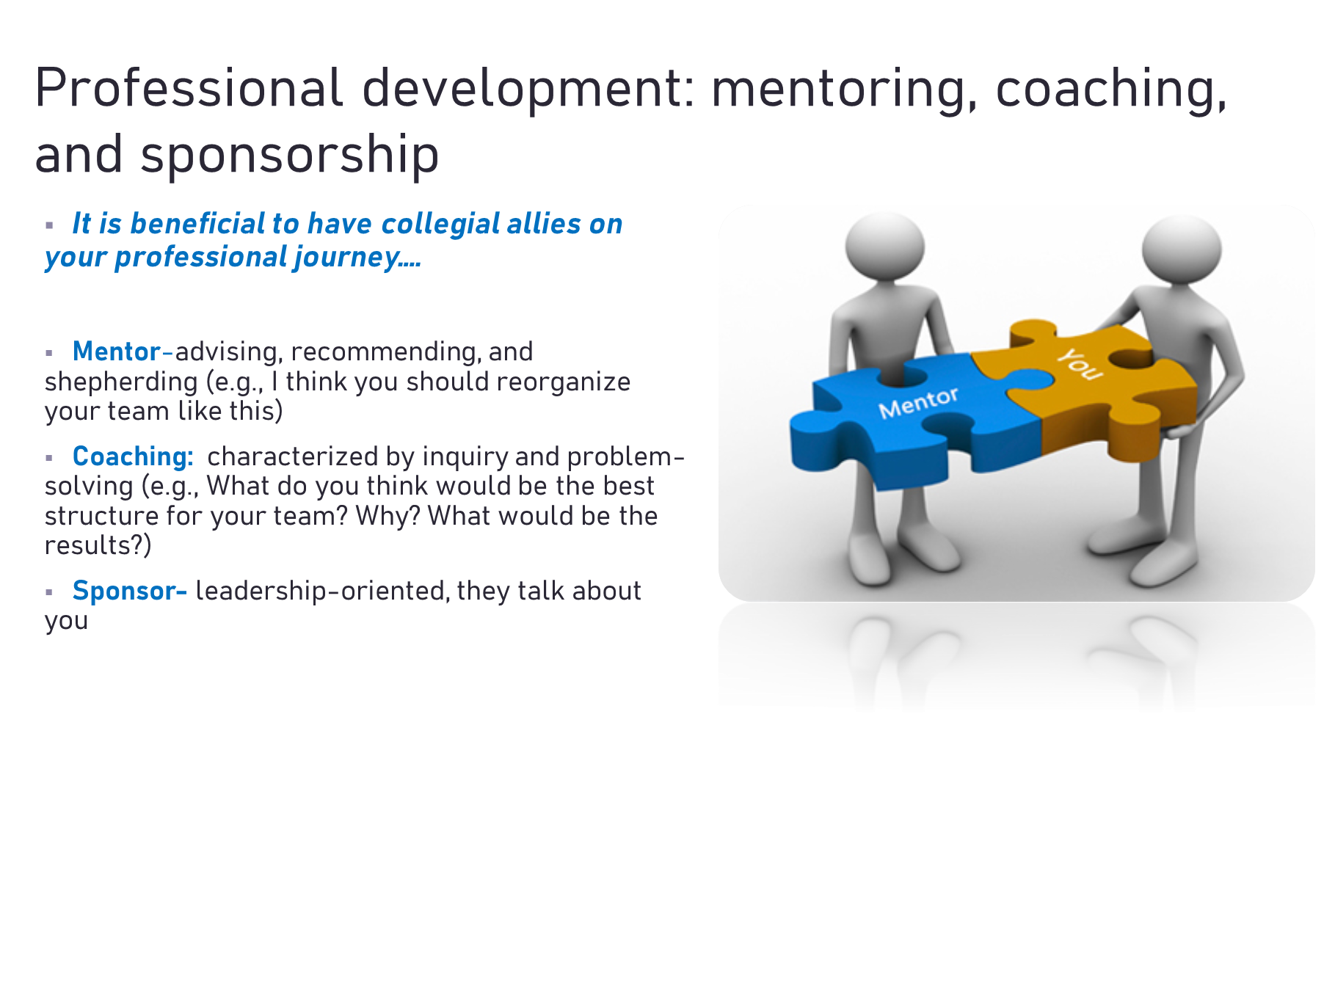

Slide 25
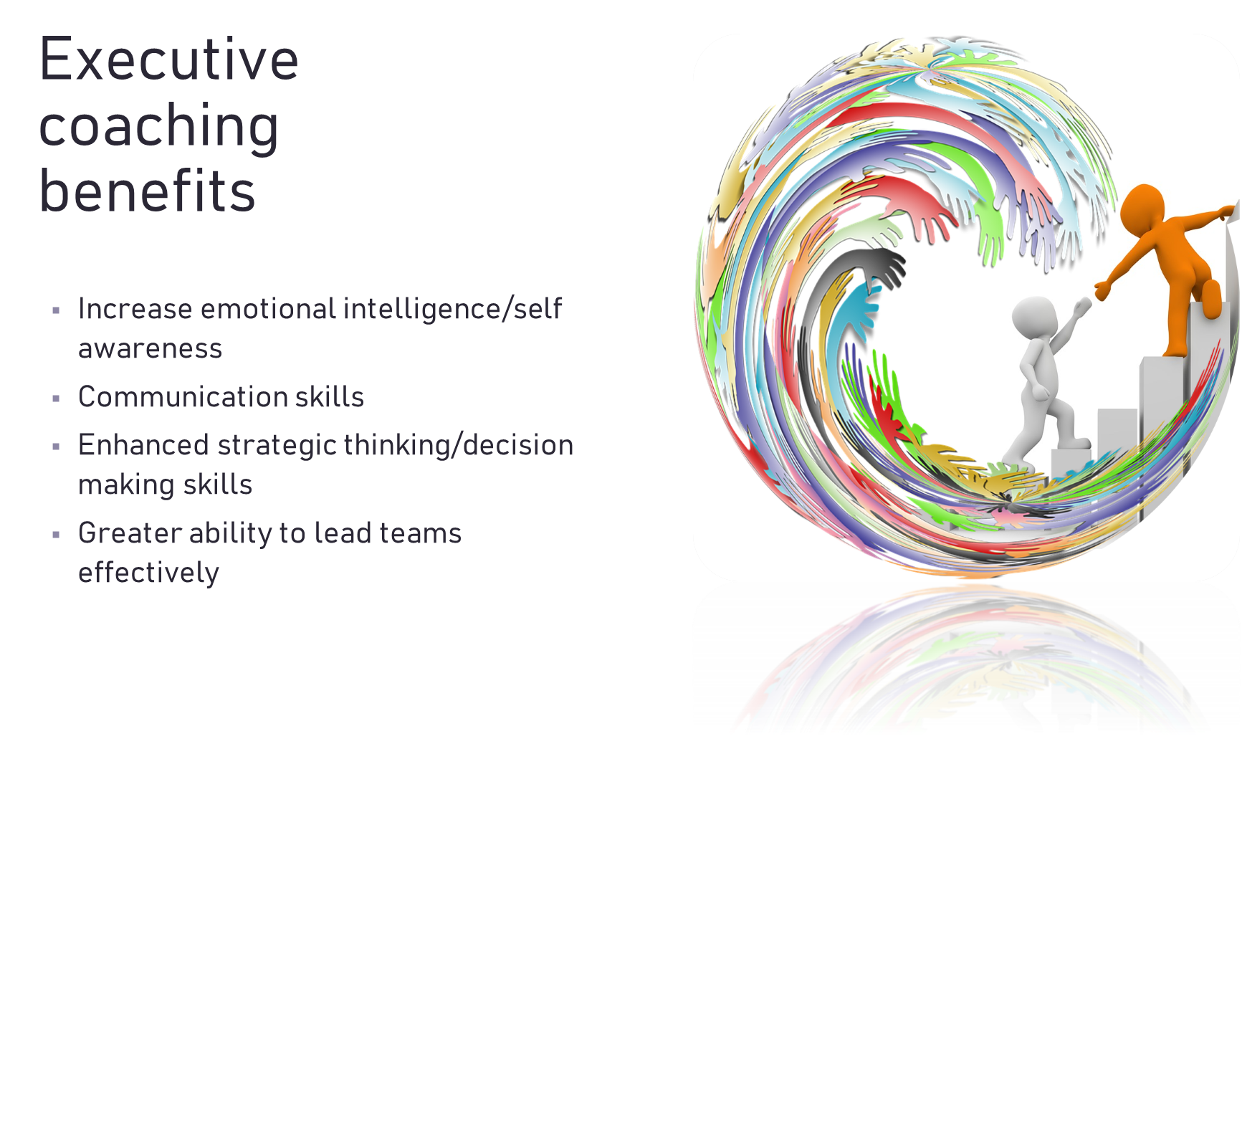

Slide 26
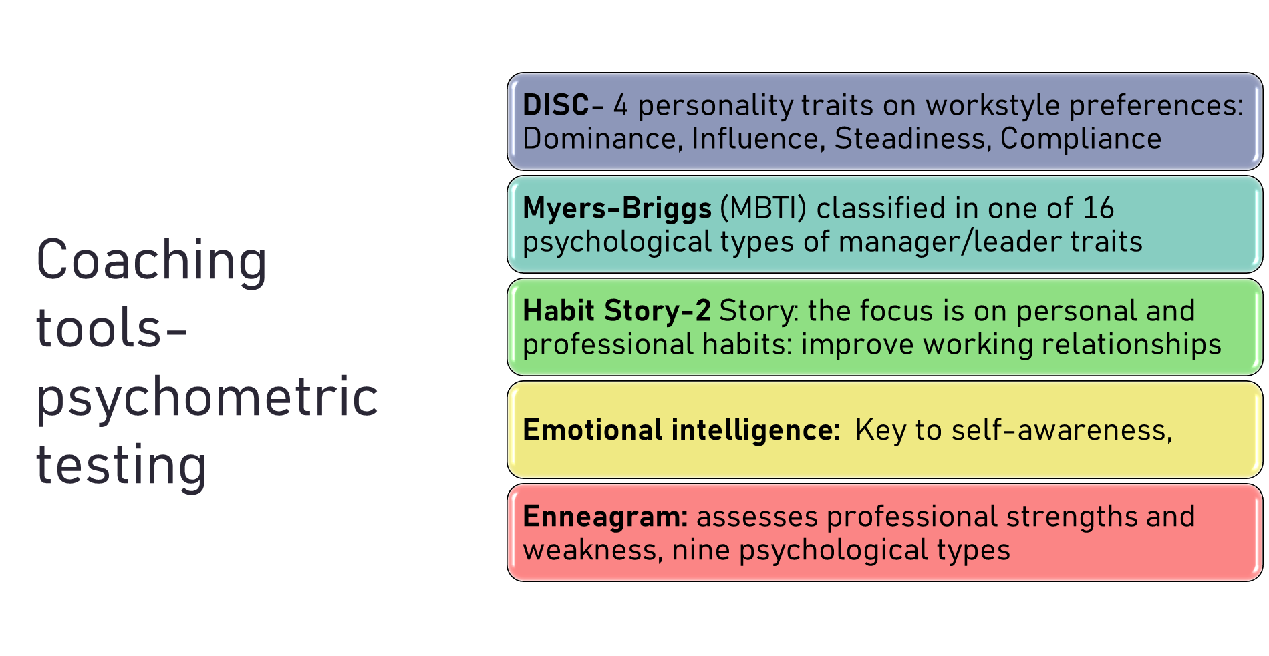

Slide 28
How to Implement the Mayo Clinic Leadership Behavior Index Survey.
Annually on all direct supervisors
Choose the behavior with lowest score
The supervisor develops their own strategy for ways to increase the score, every 1-3 months review progress
Compare the next annual survey to the prior one
Incentivize improvements or when overall scores are at an expected value.

Slide 29
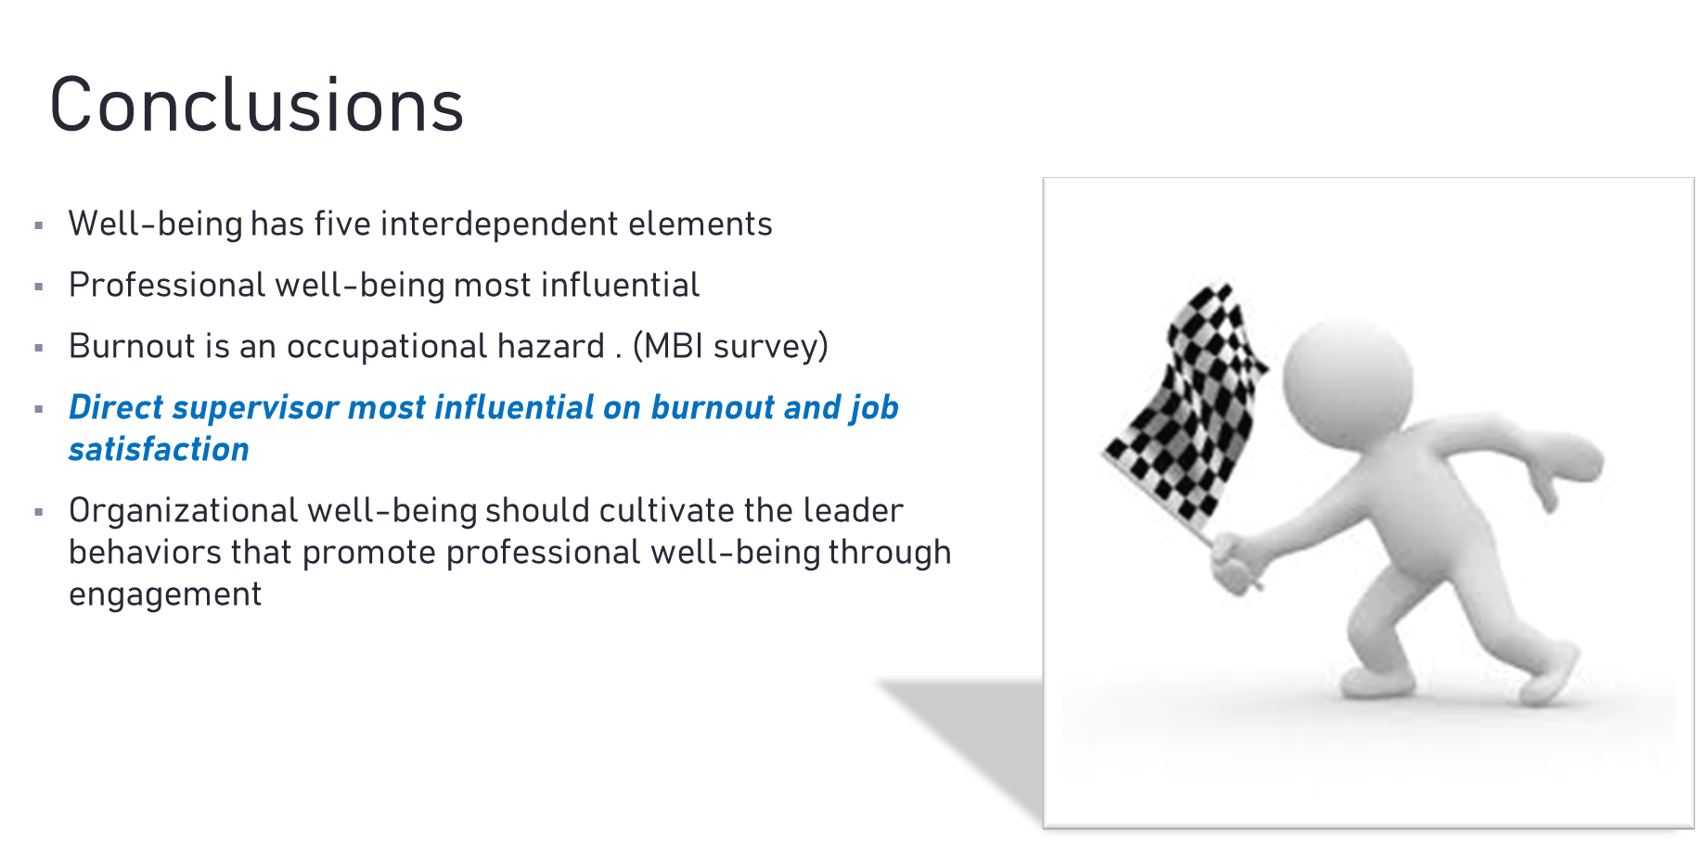

Slide 30
